Slide 1
Lecture 01

Slide 2
NUMERICAL METHODS

Slide 3
An Introduction

Slide 4
What Are Numerical Methods?
Techniques by which mathematical problems are formulated so that they can be solved with arithmetic operations {+,-,*,/} that can then be performed by a computer.
Algorithms are used to obtain numerical solutions of a mathematical problem.

Slide 5
Numerical Methods
Why do we need them?
1. No analytical solution exists.
2. An analytical solution is difficult to obtain
or not practical.

Slide 6
Why You Need to Learn Numerical Methods?
Numerical methods are extremely powerful problem-solving tool
During your career, you may often need to use commercial computer programs (canned programs) that involve numerical methods. You need to know the basic theory of numerical methods in order to be a better user.
You will often encounter problems that cannot be solved by existing canned programs; you must write your own program of numerical methods.

Slide 7
Why You Need to Learn Numerical Methods?
4.Numerical methods are an efficient vehicle for learning to use computers.
5.Numerical methods provide a good opportunity for you to reinforce your understanding of mathematics.
You need that in your life as an engineer or a scientist.

Slide 8
Outlines of the Course
Error Analysis
Taylor Theorem
Solution of nonlinear Equations
Interpolation
Least Squares curve fitting
Numerical Differentiation
Numerical Integration
Solution of ordinary differential equations
Solution of Partial differential equations

Slide 9
LIST OF PRACTICALS
Difference Table
Newton forward difference Interpolation
Newton Backward Difference Interpolation
Interpolation using Lagrange formula
Derivative using Newton Forward difference formula
Derivatives using Newton back ward
Difference formula
Numerical Integration by using Trapozoidal Rule
Numerical Integration by using Simpson’s 1/3 Rule

Slide 10
LIST OF PRACTICALS
Numerical Integration by using Simpson’s 3/8 l Rule
Differential Equations by Euler’s Method
Differential Equations by Euler’s modified Method
Differential Equations by Runge-Kutta Method
Non Linear Equations by Bisection Method
Non Linear Equations by Secant Method
Non Linear Equations by Raphson Method
Non Linear Equations by Method of false position

Slide 11
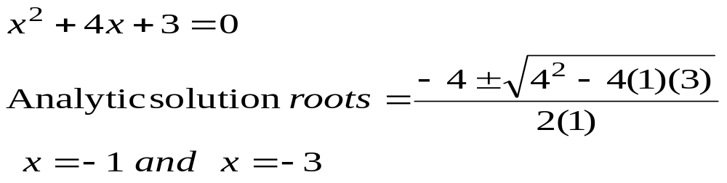
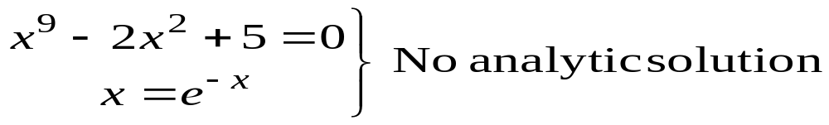
Solution of Nonlinear Equations
Some simple equations can be solved analytically
Many other equations have no analytical solution

Slide 12
Methods for solving Nonlinear Equations
Bisection Method
Newton-Raphson Method
Secant Method

Slide 13
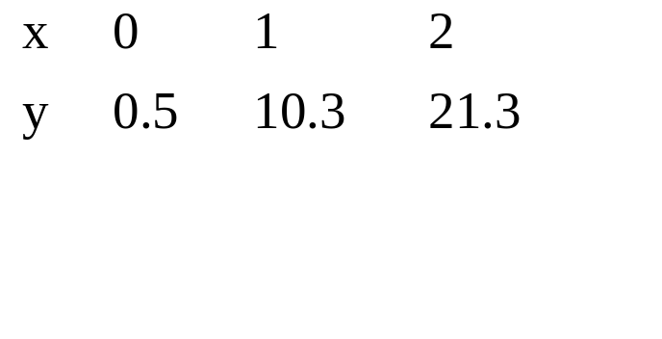
Curve Fitting
Given a set of data
Select a curve that best fit the data. One choice is find the curve so that the sum of the square of the error is minimized.

Slide 14

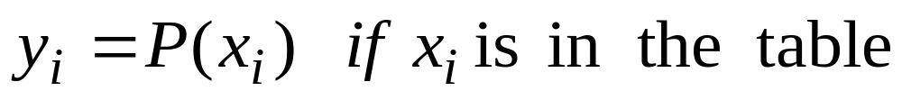
Interpolation
Given a set of data
find a polynomial P(x) whose graph passes through all tabulated points.

Slide 15
Methods for Curve Fitting
Least Squares
  Linear Regression
  Nonlinear least Squares Problems
Interpolation
  Newton polynomial interpolation
  Lagrange interpolation
  Cubic Spline
  Bezier Curves

Slide 16
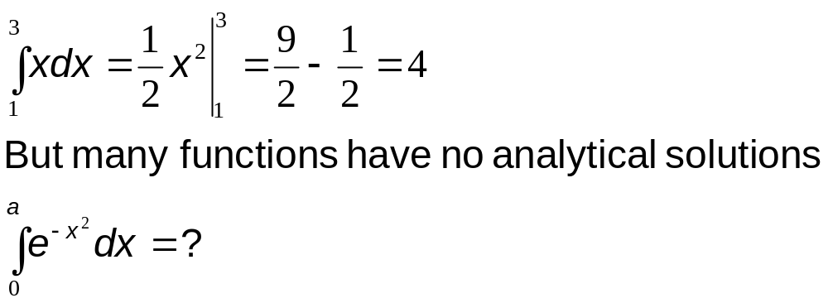
Integration
Some functions can be integrated analytically

Slide 17
Methods for Numerical Integration
Upper and Lower Sums
Trapezoid Method
Romberg Method
Gauss Quadrature

Slide 18
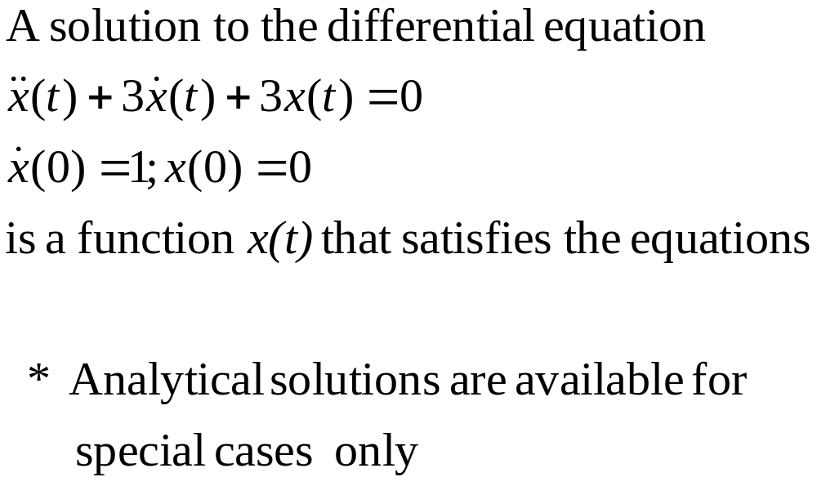
Solution of Ordinary Differential Equations

Slide 19
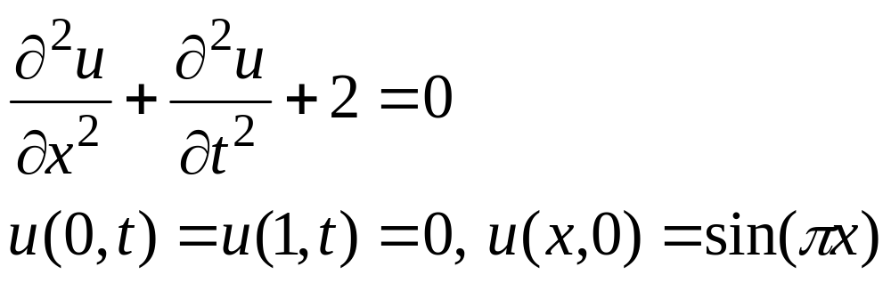
Solution of Partial Differential Equations
Partial Differential Equations are more difficult to solve than ordinary differential equations

Slide 20
LECTURE # 2

Slide 21
ERROR ANALYSIS

Slide 22
Number Representation and Computer Accuracy
Number Representation
Normalized Floating Point Representation
Rounding and Chopping

Slide 23
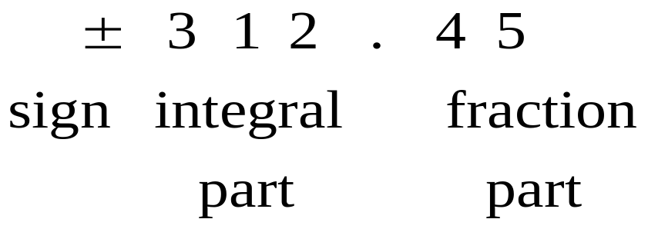
Representing Real Numbers
You are familiar with the decimal system
Decimal System Base =10 , Digits(0,1,…9)
Standard Representations

Slide 24
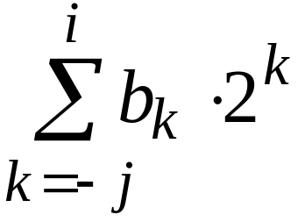
Fractional Binary Numbers
2^{i}
2^{i–1}
4
• • •
2
1
b_{i}
b_{i–1}
• • •
b₂
b₁
b₀
.
b_{–1}
b_{–2}
b_{–3}
• • •
b_{–j}
1/2
1/4
• • •
1/8
2^{–j}
Representation
  Bits to right of “binary point” represent fractional powers of 2
  Represents rational number:

Slide 25
Frac. Binary Number Examples
Value Representation
  5-3/4 101.11₂
  2-7/8 10.111₂
  63/64 0.111111₂
Observations
  Divide by 2 by shifting right
  Multiply by 2 by shifting left
  Numbers of form 0.111111…₂ just below 1.0
    1/2 + 1/4 + 1/8 + … + 1/2^{i} + … → 1.0
    Use notation 1.0 – ε

Slide 26
Representable Numbers
Limitation
  Can only exactly represent numbers of the form x/2^{k}
  Other numbers have repeating bit representations
Value Representation
  1/3 0.0101010101[01]…₂
  1/5 0.001100110011[0011]…₂
  1/10 0.0001100110011[0011]…₂

Slide 27
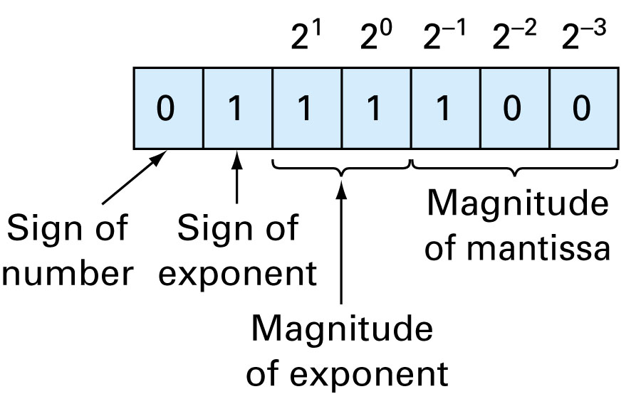
7-Bit Representation
(sign: 1 bit, Mantissa 3bits,exponent 3 bits)

Slide 28
Representation
Hypothetical Machine (real computers use ≥ 23 bit mantissa)
Mantissa 3 bits exponent 2 bit sign 1 bit
Possible machine numbers
.25 .3125 .375 .4375 .5 .625 .75 .875
1 1.25 1.5 1.75

Slide 29
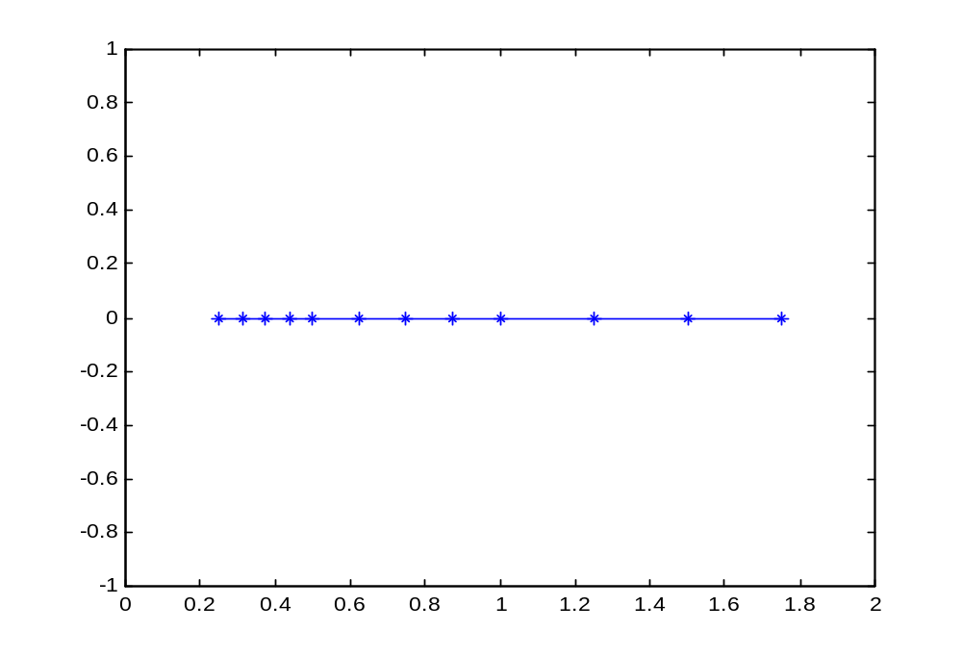
Representation
Gap near zero

Slide 30
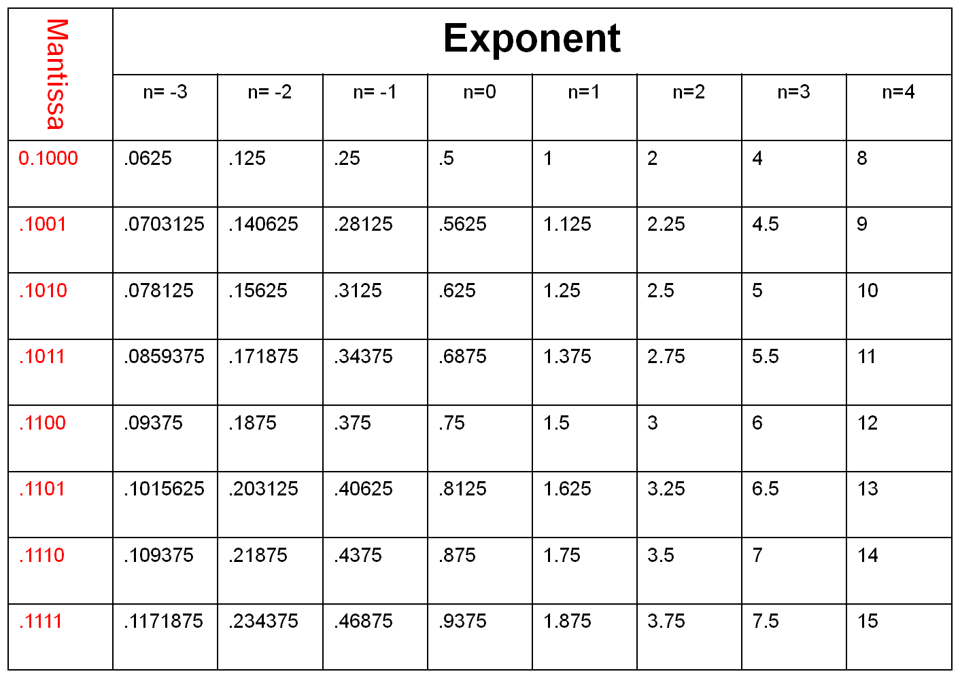

Slide 31
Remarks
Numbers that can be exactly represented are called machine numbers
Difference between machine numbers is not uniform
sum of machine numbers is not necessarily a machine number
0.25 + .3125 =0.5625 (not a machine number)

Slide 32
IEEE 754 STANDARDS

Slide 33
Floating Point Representation
Numerical Form
  (-1)^{s} M 2E
    Sign bit s determines whether number is negative or positive
    Significand M normally a fractional value in range [1.0,2.0).
    Exponent E weights value by power of two
Encoding
  MSB is sign bit
  exp field encodes E
  mantissa field encodes M
s
exp
mantissa

Slide 34
Floating Point Precisions
s
exp
mantissa
Encoding
  MSB is sign bit
  exp field encodes E
  Mantissa field encodes M
Sizes
  Single precision: 8 exp bits, 23 mantissa bits
    32 bits total
  Double precision: 11 exp bits, 52 mantissa
  bits
    64 bits total

Slide 35
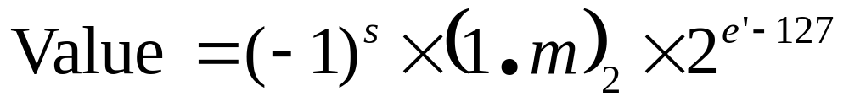
IEEE-754 Format Single Precision
32 bits for single precision
0 | 0 | 0 | 0 | 0 | 0 | 0 | 0 | 0 | 0 | 0 | 0 | 0 | 0 | 0 | 0 | 0 | 0 | 0 | 0 | 0 | 0 | 0 | 0 | 0 | 0 | 0 | 0 | 0 | 0 | 0 | 0
Sign
(s)
Biased
Exponent (e’)
Mantissa (m)

Slide 36
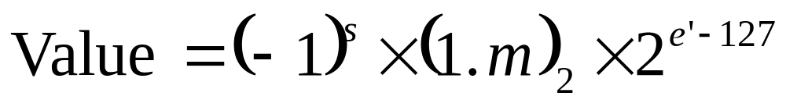
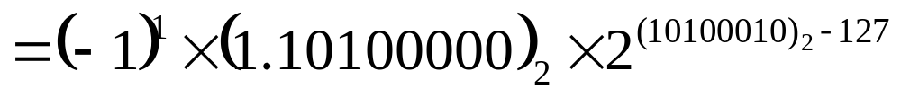
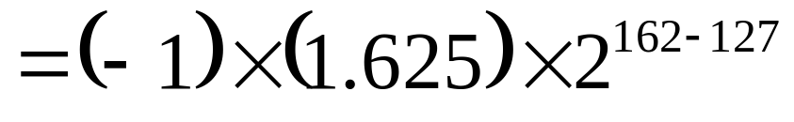
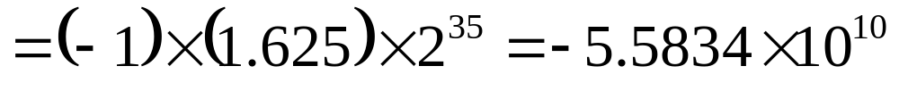
Example
1 | 1 | 0 | 1 | 0 | 0 | 0 | 1 | 0 | 1 | 0 | 1 | 0 | 0 | 0 | 0 | 0 | 0 | 0 | 0 | 0 | 0 | 0 | 0 | 0 | 0 | 0 | 0 | 0 | 0 | 0 | 0
Sign
(s)
Biased
Exponent (e’)
Mantissa (m)

Slide 37
“Normalized” Numeric Values
Condition
  exp ≠ 000…0 and exp ≠ 111…1
Exponent coded as biased value
  E = Exp – Bias
    Exp : unsigned value denoted by exp
    Bias : Bias value
      Single precision: 127 (Exp: 1…254, E: -126…127)
      Double precision: 1023 (Exp: 1…2046, E: -1022…1023)
      in general: Bias = 2^{e-1} - 1, where e is number of exponent bits
Significand coded with implied leading 1
  M = 1.xxx…x₂
    xxx…x: bits of frac
    Minimum when 000…0 (M = 1.0)
    Maximum when 111…1 (M = 2.0 – ε)
    Get extra leading bit for “free”

Slide 38
Normalized Encoding Example
Value
  Float F = 15213.0;
  15213₁₀ = 11101101101101₂ = 1.1101101101101₂ X 2¹³
Significand
  M = 1.1101101101101₂
  frac = 11011011011010000000000₂
Exponent
  E = 13
  Bias = 127
  Exp = 140 = 10001100₂

Slide 39
Rounding and Chopping
Rounding: Replace the number by the nearest machine number
Chopping: Throw all extra digits

Slide 40
Lecture 03

Slide 41
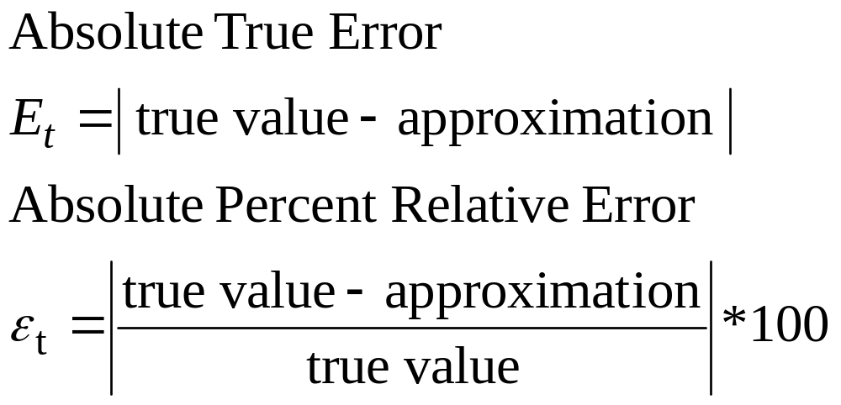
Error Definitions
True Error can be computed if the true value is known

Slide 42
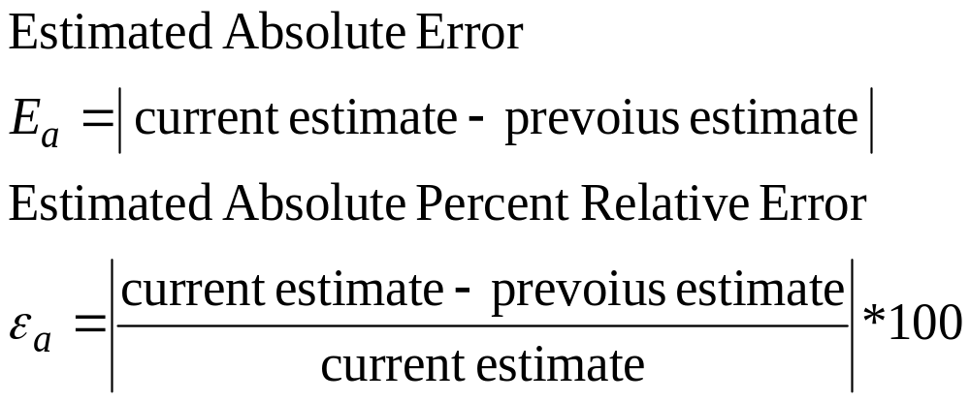
Error Definitions
Estimated Error When the true value is not known

Slide 43
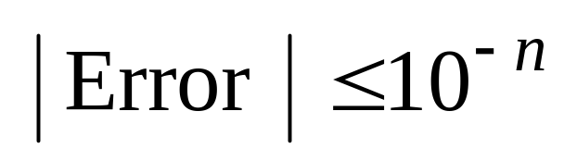
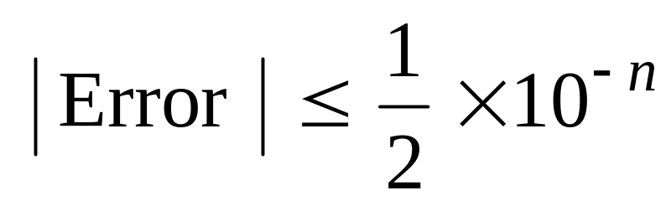
Notation
We say the estimate is correct to n decimal digits if
We say the estimate is correct to n decimal digits rounded if

Slide 44
Types Error
Truncation Error
This refers to errors introduced when a more complicated mathematical expression is replaced with a more elementary formula
Round-off Error
A computer’s representation of real numbers is limited to the fixed precision of the mantissa. True values are sometimes not stored exactly by a computer’s representation. This is called round-off error

Slide 45
Significant Digits
Significant digits are those digits that can be used with confidence.

Slide 46
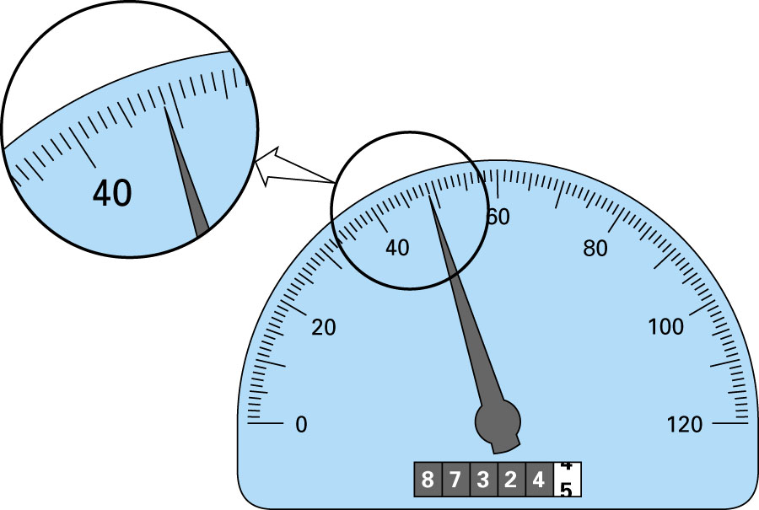
48.9

Slide 47
Accuracy and Precision
Accuracy is related to closeness to the true value
Precision is related to the closeness to other estimated values

Slide 48
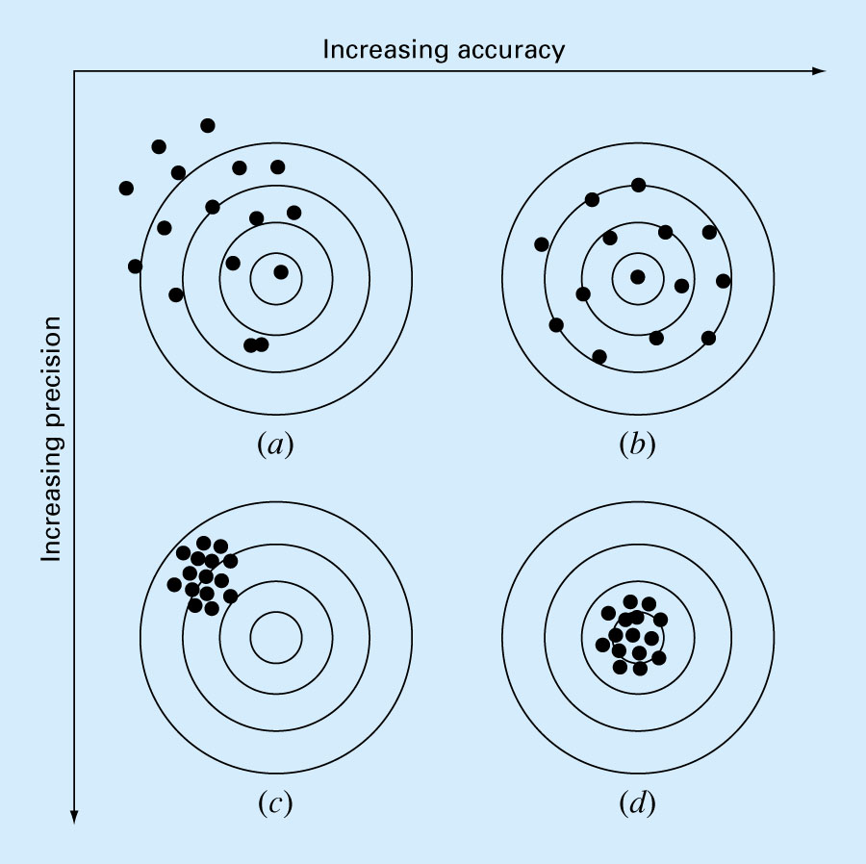

Slide 49

Approximation
Definition:-
The number p is to approximate q to d significant digits if d is the largest nonnegative integer for which

Slide 50
Loss of Significance
Subtractive Cancellation

Slide 51
Summary
Number Representation
Number that have finite expansion in one numbering system may
have an infinite expansion in another numbering system.
Normalized Floating Point Representation
  Efficient in representing very small or very large numbers
  Difference between machine numbers is not uniform
  Representation error depends on the number of bits used in the mantissa.

